Slide 1

Fitter 3
Minds – VET - Jobs
Presentation
Coaching concept of
BBS Syke EUROPASCHULE
by
Silke Hillermann

Slide 2
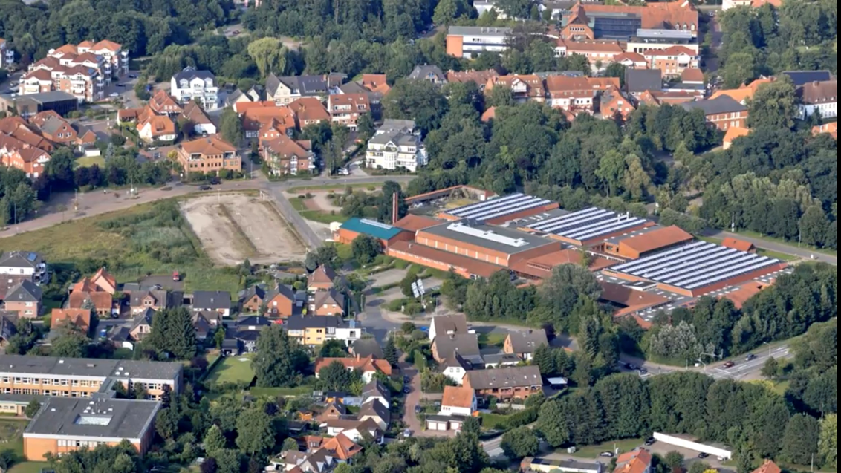
BBS Syke EUROPASCHULE is situated in the North of Germany South of Bremen

Slide 3
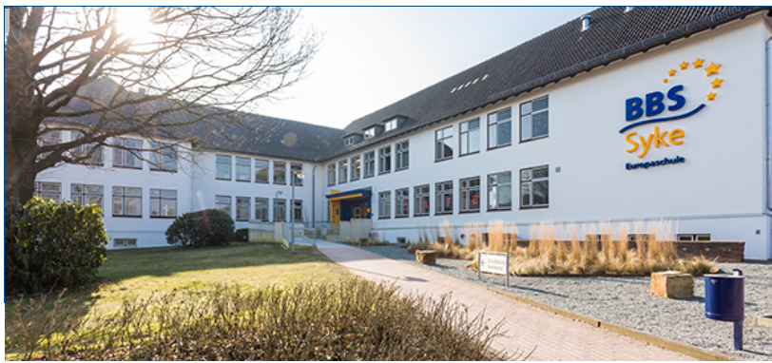
BBS Syke EUROPASCHULE – facts and figures
Notes:
About 3,200 students
About 180 teachers and staff
7 departments
160 classes, level 1-6
2000 in the dual system in about 25 professions
1200 full-time students

Slide 4

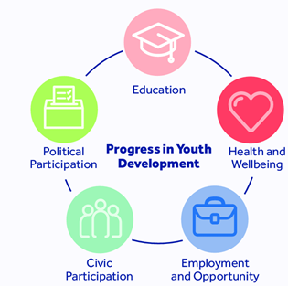

BBS Syke EUROPASCHULE – our core business
Notes:
We offer
an employment-oriented qualification of students.
We support students
in their personal development and
them acquiring competences either at home or abroad.
We work in close cooperation with
training companies,
chambers,
parents,
a variety of schools as well as with
partners abroad.

Slide 5
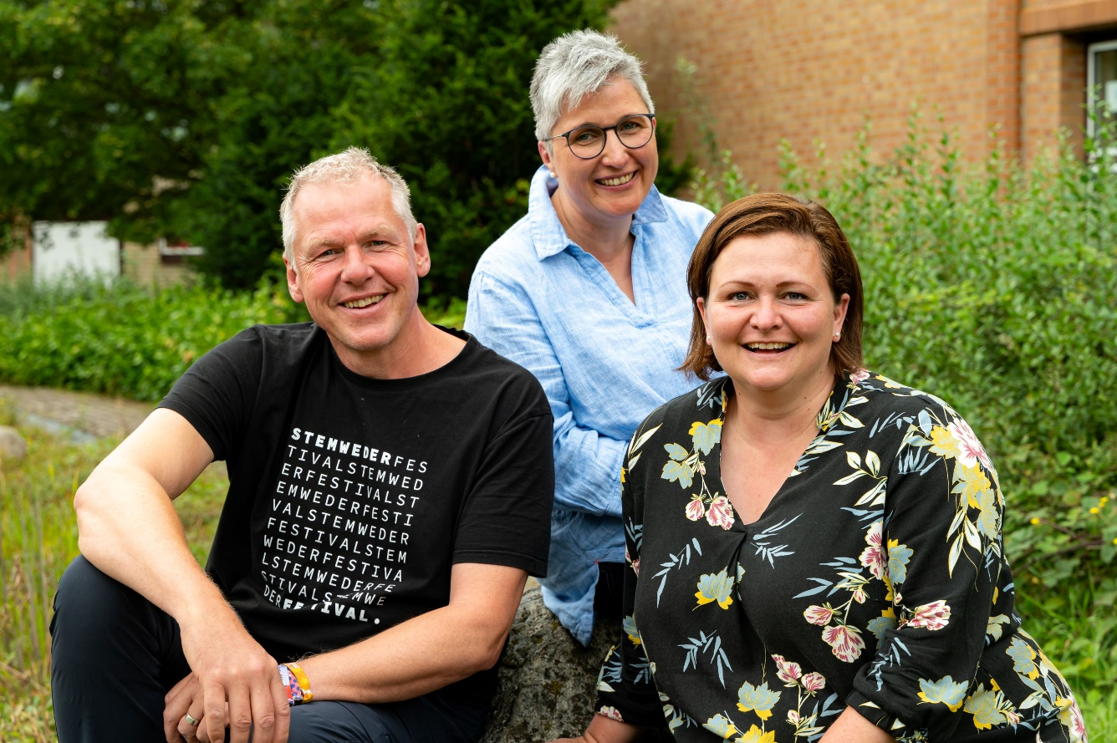
BBS Syke EUROPASCHULE – our coaching concept:
Our school coaches
Notes:
Focus on…
Problems with (fellow) students, teachers, trainers, colleagues, superiors, friends, parents...?
Or …
Dissatisfaction with school, private or company situation?
Principles
Voluntary
Confidential
Helping people help themselves

Slide 6
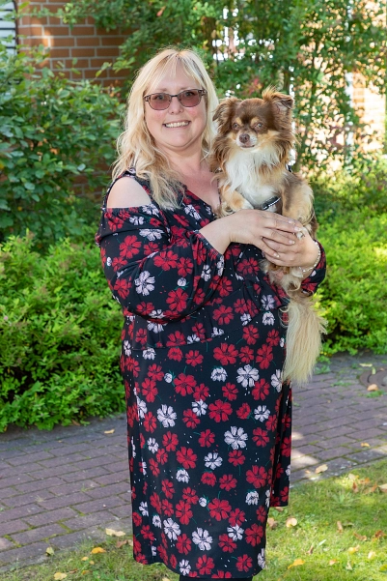
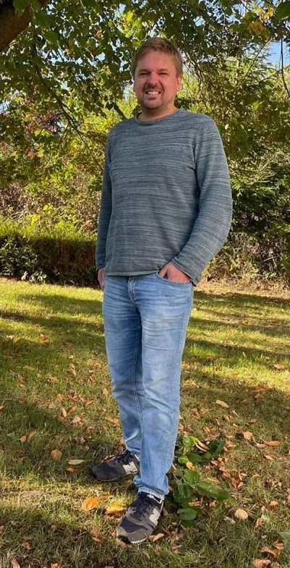
BBS Syke EUROPASCHULE – our coaching concept:
Our social workers
Notes:
Focus on:
Vocational entry school (BES) / production class
What kind of topics could these be?
Conflicts with classmates or teachers
My degree is in jeopardy/
I don't know what to do next academically or professionally
Family problems or
problems among friends
Cooperation with:
Office for Social Services/
Youth Welfare Office
Doctors
Psychologists
Addiction counseling
Advice centers for domestic violence
Violence prevention
Women's shelters

Slide 7
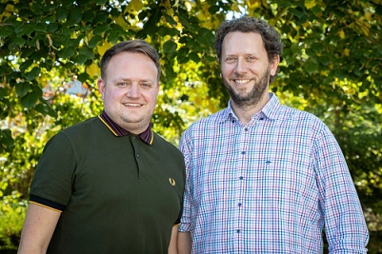
BBS Syke EUROPASCHULE – our coaching concept:
Our school pastoral care
Notes:
Principles
Voluntary
Confidential
Responsibility

Slide 8
BBS Syke EUROPASCHULE – our coaching concept:
Professional coaching
Career information exchange
General Information
BIB (Career Information Fair)
Cooperation with the employment agency
Notes:
1.
Notices in the departments,
company presentations,
regular visits by employees of the employment agency,
information evenings, etc.
2.
The BIB is an excellent opportunity to get to know a wide variety of professions. Around 120 companies and institutions present themselves at this trade fair. Through live demonstrations, information material and personal conversations, you can learn a lot and make your first contacts.
3. See above

Slide 9
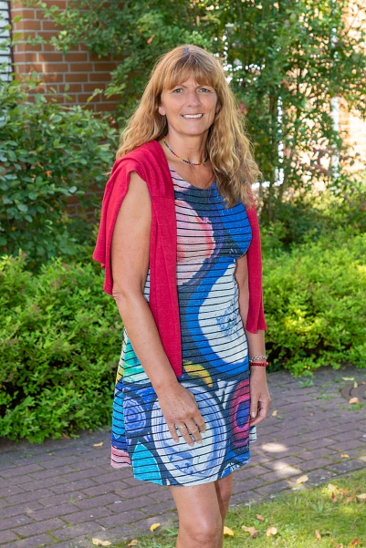
BBS Syke EUROPASCHULE – our coaching concept:
School-life-balance
Notes:
Main approaches:
Experiential education,
mediation and
relaxation training

Slide 10
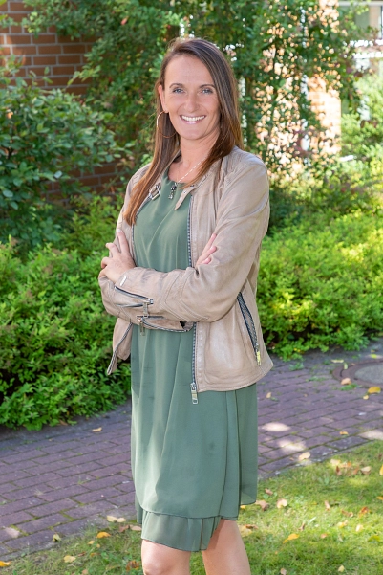
BBS Syke EUROPASCHULE – our coaching concept:
Coaching for teachers
Notes:
4 Workshops:
Module 1: Authentic Communication
Module 2: Dealing with challenging situations
Module 3: What glasses do you wear?
Module 4: Your cinema – your film
Single coaching
to overcome professional challenges

Slide 11

BBS Syke EUROPASCHULE – our coaching concept:
Psychological training for teachers
Notes:
We just started to have 10 colleagues trained in professional consulting/coaching communication and motivation. They learn to (re-)activate the abilities of those seeking advice and to successfully accompany and support them in private and professional contexts, even in challenging situations.

Slide 12
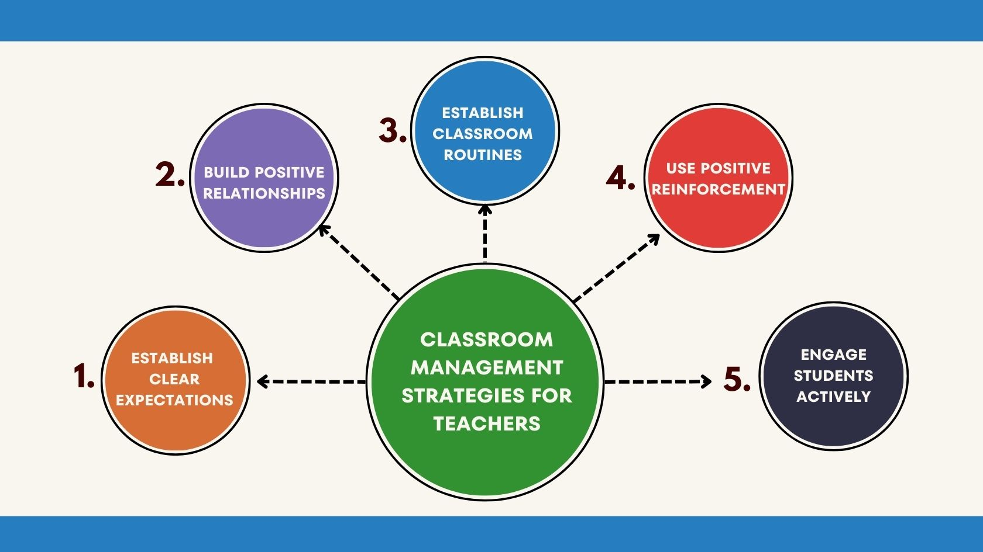
BBS Syke EUROPASCHULE – our coaching concept:
Classroom Management courses
Notes:
We just started to establish mandatory teacher´s training as we believe that successful teaching depends on successful classroom management. The joint creation of rules and routines and a good social climate that is conducive to learning are essential building blocks for learning. In addition, dealing with disruptions and of course the high quality of teaching are crucial to ensuring that all students learn a lot.

Slide 13
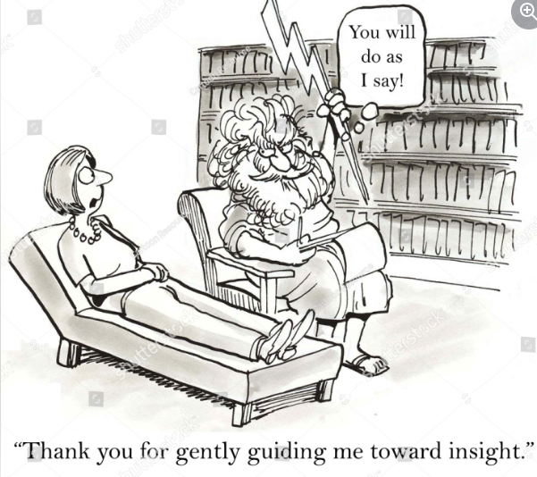
BBS Syke EUROPASCHULE –
Thank you for listening
Notes:
We just started to establish mandatory teacher´s training as we believe that successful teaching depends on successful classroom management. The joint creation of rules and routines and a good social climate that is conducive to learning are essential building blocks for learning. In addition, dealing with disruptions and of course the high quality of teaching are crucial to ensuring that all students learn a lot.

